Slide 1
OOP
Inline Function
Default Parameters in a Function
Function Overloading
Operator Overloading

Slide 2
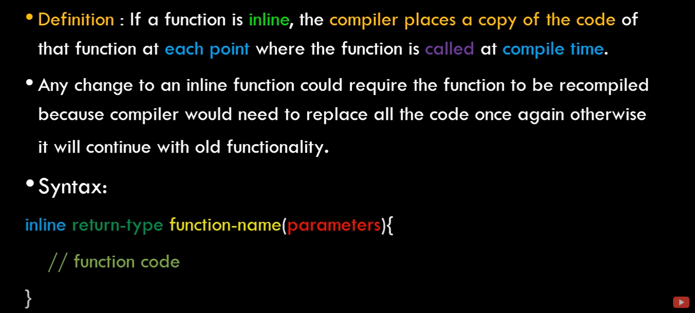

Slide 3
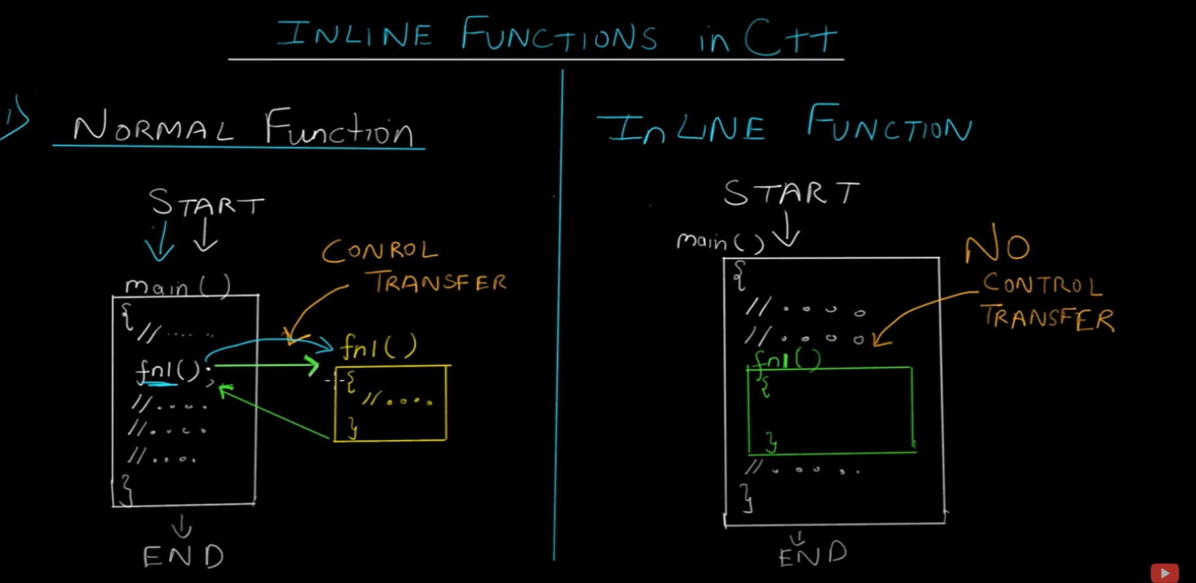

Slide 4
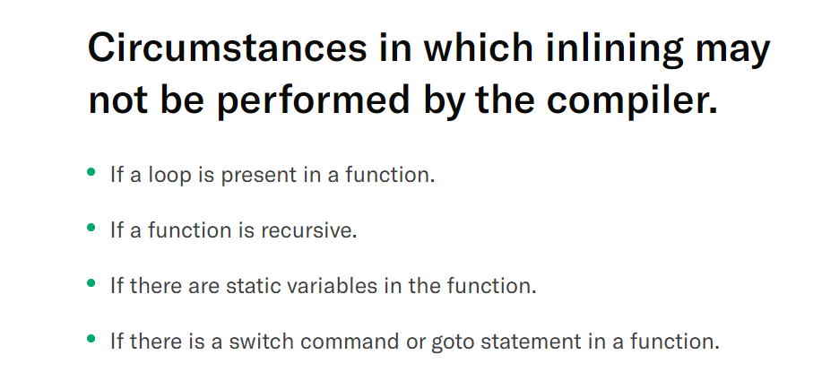

Slide 5
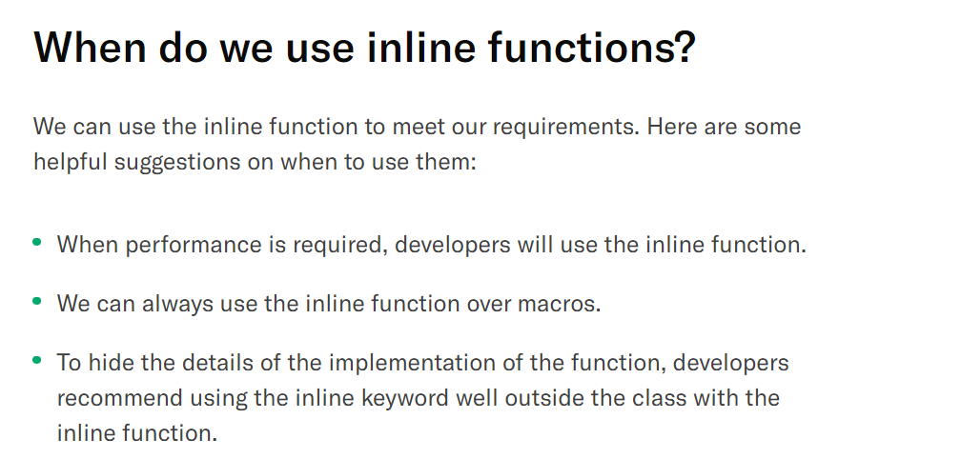

Slide 6
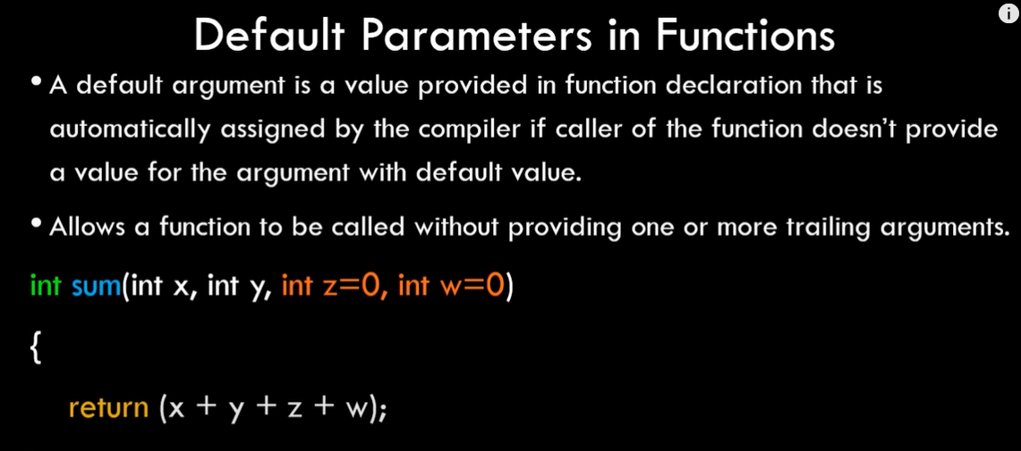

Slide 7
